Slide 1
Tech-driven solutions for undertrial prisoners in India
PIP2001 Capstone Project
Review-2
Batch Number: CBC-G11
Under the Supervision of,
Dr. M Swapna
Associate Professor
School of Computer Science and Engineering
Presidency University
ROLL NO | STUDENT NAME
20211CBC0059 20221LBC0001 20211CBC0056 20211CBC0057 20211CBC0054 | AISHWARYA S ANUHYA RAM MONISH J ABHISHEK B SNEHA S
Name of the Program: B TECH
Name of the HoD: PRAVINTHA RAJA
Name of the Program Project Coordinator: SUMA GOWDA
Name of the School Project Coordinators: Dr. Sampath A K / Dr. Abdul Khadar A / Mr. Md Ziaur Rahman

Slide 2
Introduction
Undertrial prisoners in India often face extended detention due to slow legal processes and lack of access to timely legal aid.
Tech-driven solutions, such as AI-based case tracking, digital legal aid platforms, and blockchain for bail management, can help streamline judicial procedures and ensure faster case resolution.
This project aims to leverage technology to improve legal accessibility, reduce case backlogs, and enhance justice delivery for undertrial prisoners.

Slide 3
Literature Review
The issue of undertrial prisoners in India has been widely studied, with reports highlighting judicial delays, overcrowded prisons, and inadequate legal aid as primary concerns.
Research indicates that digital interventions, such as AI-driven legal analytics and blockchain-based bail management, can enhance efficiency in the justice system.
Studies on legal tech solutions suggest that mobile applications for case tracking and automated legal aid platforms improve access to justice.
The National Judicial Data Grid (NJDG) and e-Courts initiatives have already demonstrated the potential of technology in expediting case management.

Slide 4
Proposed Method
This project aims to develop a tech-driven solution to address the challenges faced by undertrial prisoners in India through digital case management, AI-driven legal aid, and blockchain-based bail tracking.
Digital Case Management System
AI-Powered Legal Aid Assistance
Blockchain-Based Bail and Case Tracking
Mobile Application for Prisoners and Legal Aid Volunteers
Integration with Government Databases

Slide 5
Objectives
Enhance Legal Accessibility
Reduce Judicial Delays
Improve Transparency
Facilitate Legal Aid Support
Streamline Bail Processing
Integrate with Existing Judicial Systems
Improve Student Learning Outcomes
Increase Awareness and Legal Literacy

Slide 6
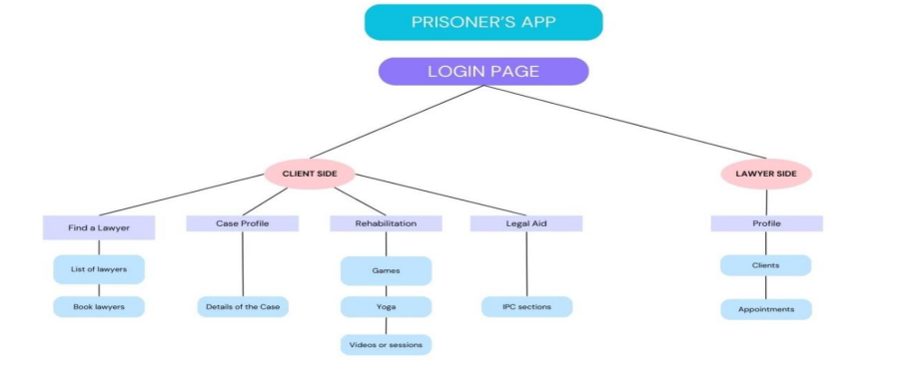
ARCHITECTURE

Slide 7
Methodology
Requirement Analysis
System Design & Development
Data Integration & Security Implementation
Testing & Validation
Deployment & Implementation
Monitoring & Evaluation

Slide 8
Timeline of the Project (Gantt Chart)
Review 0
Review 1
Review 2
Review 3
Review 4
Review
Initiation
Planning
Designing
Testing
Title Selection, Github repo creation,
Requirement Gathering
Requirement Analysis, Setting up of required environments
Data Integration & Security Implementation
Testing & Validation
Checking for error and debugging to check for bugs
Final Viva Voce

Slide 9
Expected Outcomes
Implementing the proposed system significantly enhance the efficiency, accessibility, and fairness of the legal system for undertrial prisoners in India.
Reduced Judicial Delays
Improved Legal Access
Efficient Bail Processing
Enhanced Transparency
Prison Decongestion
Stronger Collaboration Between Stakeholders
Data-Driven Legal Reforms
Higher Legal Awareness

Slide 10
GITHUB REPOSITORY
GITHUB REPOSITORY
github.com/Anuhyaram/Tech-Driven-Solutions-For-Under-Trail-Prisoners-in-India.git

Slide 11
Conclusion
Technology as a Catalyst for Justice – The project demonstrates how AI, blockchain, and digital platforms can significantly improve legal access, case tracking, and bail processing for undertrial prisoners.
Reduction in Judicial Delays – By automating case updates, streamlining bail approvals, and integrating with judicial databases, the system helps expedite case resolutions.
Improved Legal Aid Accessibility – AI-powered chatbots, mobile applications, and digital legal resources empower undertrial prisoners with timely legal assistance and awareness.
Enhanced Transparency and Security – Blockchain-based case tracking ensures tamper-proof legal records, reducing the chances of manipulation or data loss.

Slide 12
References (IEEE Paper format)
1] G. Duwe and K. Kim, ‘‘Out with the old and in with the new? An empirical comparison of supervised learning algorithms to predict recidivism,’’ Criminal Justice Policy Rev., vol. 28, no. 6, pp. 570–600, Jul. 2017.
[2] M. Mohandes, M. Deriche, and S. O. Aliyu, ‘‘Classifiers combination techniques: A comprehensive review,’’ IEEE Access, vol. 6, pp. 19626–19639, 2018.
[3] J. van Dijk, S. Kalidien, and S. Choenni, ‘‘Smart monitoring of the criminal justice system,’’ Government Inf. Quart., vol. 35, no. 4, pp. S24–S32, Oct. 2018

Slide 13
Thank You

